Slide 1

RECOGNITION
Wanna Enjoy?? Just get Recognition……

Slide 2

Our website
RECOGNITION
Is a leading concert and event management company which enables you to be updated with all the concerts in town

Slide 3
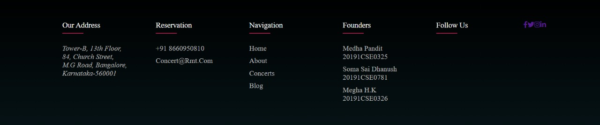






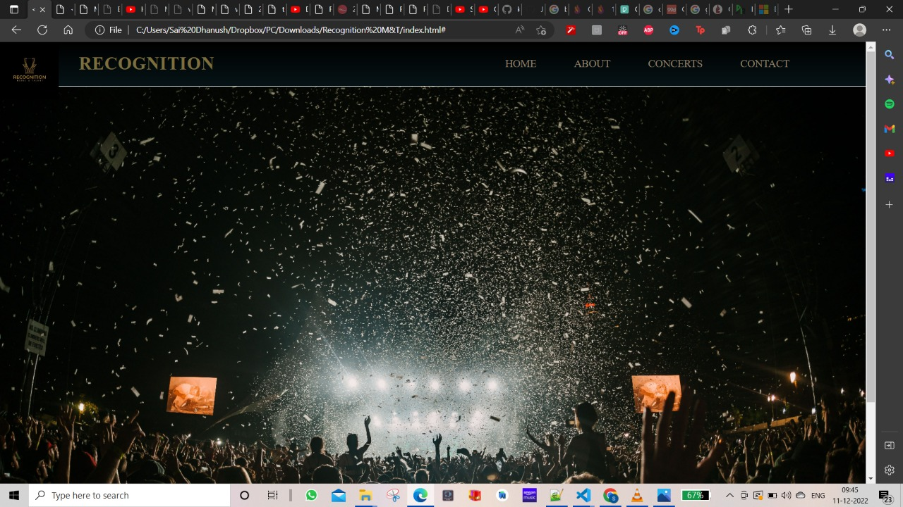

Slide 4
This was just a glimpse of our on going website

Slide 5

Technologies used
HTML
CSS
JS
BOOTSTRAP
PHP

Slide 6
OUR TEAM
SOMA SAI DHANUSH
20191CSE0781
MEGHA H.K
20191CSE0326
MEDHA PANDIT
20191CSE0325
members

Slide 7
THANK YOU

